Slide 1
‘Large’ Data Methods
John McCallum
Marcus Davy
Samantha Baldwin

Slide 2
Statistical Genomics in 2012+
Larger is getting cheaper and larger
Context-specific SNP marker discovery
Population pool methods
Genotyping by sequencing
Global methods
Reference-based methods
Largeness requires scalable server-based computing cloud, cluster etc
Diverse tools, scripts available for UNIX (ie OSX,Linux)

Slide 3
To keep sane, use approaches that are
Scalable
Open source
Reproducible
Documented
Identifiable
Disciplined

Slide 4
Tools and Learning Goals
Unix shell essentials
Documentation, help and formats
Accessing servers and moving files
Using third-party scripts and executables
Visualization
Galaxy equivalents

Slide 5
Some Processing Tasks
Search
Map
Filter
Join
(re) Format

Slide 6
Why Unix?
It makes the web and my phone work
Leading platform for scientific computing
Secure
Scalable
Many flavours to suit your needs

Slide 7
Outline
An intro to the Unix CL -Exploring data and formats (1 h)
Running Analyses -Variant detection & analysis(1 h)
Visualization with R and IGV (1/2 h)
Formats and data manipulation in Galaxy (1/2 h)

Slide 8
The Data
Fragmented, barcoded PCR amplicons from 7 populations, 2x 1/16 454 Ti plate
Raw data
Reference fasta sequence (homozygous reference)
Fastq files, one per population per plate segment
Workflow
Read mapping with BWA SW
Manipulation and SNP calling with Samtools
Population genetic analyses with PoPoolation2
Visualization with IGV and ggplot/ggbio

Slide 9
The Question
How much nucleotide diversity?
Which snps show significant frequency differences among populations?

Slide 10
Its All About Formats!
Input and outputs should stick to standard common formats
Fasta – Raw nucleotide/peptide format
(From Sanger sequencing, assembly etc)
Fastq – Raw sequence information
(From NGS illumina Roche 454 etc)
sam/bam format – Sequence Alignment/Map format
(Standard alignment mapper output format)
GFF – General feature format

Slide 11
Files etc
Regular files-human readable text
Directories
Executable files
Compiled
Special text files
Symbolic links -'shortcuts'

Slide 12
ls *.fastq list to stdout
ls *.fastq > somefile redirect to file
cat somefile to stdout
cat somefile | head pipe file to head
cat > somefile read from stdin/ctrl d save

Slide 13
Connect to a Server and Move Files-SSH Protocols
Unix/OSX Terminal
ssh username@serveraddress.com
Windows
Putty
Xming
Winscp

Slide 14
Exercise-SSH and SCP
Get your IP address
ifconfig | grep 'inet addr'
Swap IP addresses with a partner
Check you can reach their IP address
ping <their IP address>
SSH to each others machine as VISG_USER
ssh visg_user@<IP address>
Copy a file to your home dir
scp visg_user@<IP address>:/VISG/00.raw/reference.fasta ~

Slide 15
> The bash shell
'Bourne-again-shell'
A command-line (CL) interface to operating system
a command interpreter
Command -option <value> argument(s)
Inputs and outputs from files or stdin/out

Slide 16
Exercise-Shell Orientation
whoami
pwd
ls /
ls -l /
ls -l ~
cd /VISG
ls -l
Who are you?
Where are you?
List the root filesystem
Long listing
Long listing of home
Go to VISG dir
List the files

Slide 17
Exploring Your Environment
visg@mint ~ $ whoami
visg
visg@mint ~ $ pwd
/home/visg
visg@mint ~ $ ls -l
total 0
visg@mint ~ $ ls -la
total 8
drwxr-xr-x 7 visg visg 180 Sep 24 09:49 .
drwxr-xr-x 5 root root 80 Sep 24 09:49 ..
-rw-r--r-- 1 visg visg 220 Sep 24 09:49 .bash_logout
drwxr-xr-x 3 visg visg 80 Sep 24 09:49 .config
drwx------ 2 visg visg 40 Sep 24 09:49 .gconf
drwxr-xr-x 3 visg visg 60 Sep 24 09:49 .local
drwxr-xr-x 2 visg visg 60 Sep 24 09:49 .mate2
drwxr-xr-x 4 visg visg 100 Sep 24 09:49 .mozilla
-rw-r--r-- 1 visg visg 675 Sep 24 09:49 .profile

Slide 18
CL Navigation
cd /VISG/00.raw
ls P<tab>
<tab>
<tab> <tab>
ls Pool1_BARCODE*
ls Pool1_BARCODE?.fastq
history
history | tail
<up arrow>
<down arrow>
< mouse double click>
<shift ins>
Move to
filename completion
All the options
List the Pool1 files
List the Pool1 fastq files
see all the history
Last few items
Back in history
Forward in history
Copy
paste

Slide 19
Exercise View, Browse and Filter
head Pool1_BARCODE2.fastq
tail Pool1_BARCODE2.fastq
less Pool1_BARCODE2.fastq
h help screen
g top of file
G bottom of file
/<pattern> search for pattern
q quit less

Slide 20
Help!
help list shell commands
help cd help for cd command
<command> may give help
man <command> read the man pages, q to exit
<command> --help
<ctrl> + c stop

Slide 21
Scripts, Executable Files and Where They Live
visg@mint ~ $ echo $PATH where it looks for executables
/usr/local/bin:/usr/bin:/bin:/usr/local/games:/usr/games
visg_user@mint ~/visg/00.raw $ which bwa where’s bwa?
/usr/bin/bwa
visg_user@mint ~/visg/00.raw $ ls -l /usr/bin/bwa
-rwxr-xr-x 1 root root 276124 Dec 12 2011 /usr/bin/bwa executable
visg_user@mint ~/visg/00.raw $ cat run.sh dump file
#!/bin/sh uses the sh interpreter ie bash
## Run qa.R script as a batch file a comment
Rscript qc.R 2> err > log
visg_user@mint ~/visg/00.raw $ head qc.R look at top of script
#!/bin/env Rscript uses the Rscript interpreter
require(ShortRead)

Slide 22
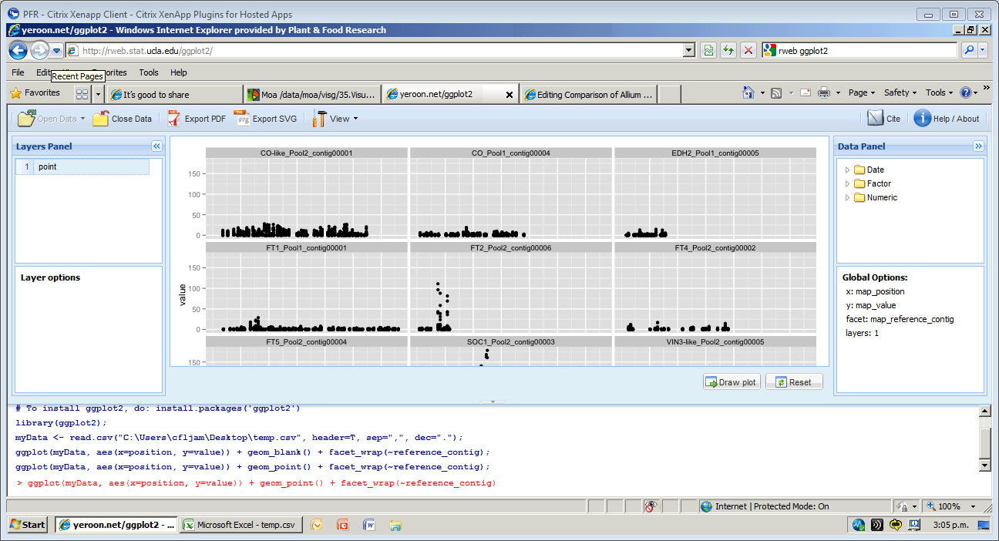
http://rweb.stat.ucla.edu/ggplot2/

Slide 23
Bootable Linux-on-a-stick
Download image http://mirror.xnet.co.nz/pub/linuxmint/iso/stable/13/linuxmint-13-mate-dvd-32bit.iso
Write to USB stick 4Gb using http://www.linuxliveusb.com/ with space for persistent data (based on Portable VirtualBox)
Customise using apt-get install => R/samtools/bwa etc
Clone image using http://www.alexpage.de/usb-image-tool/

